Slide 1
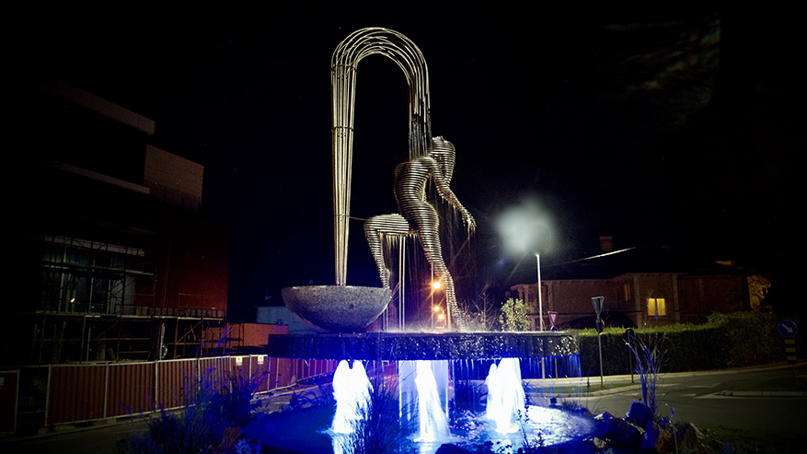
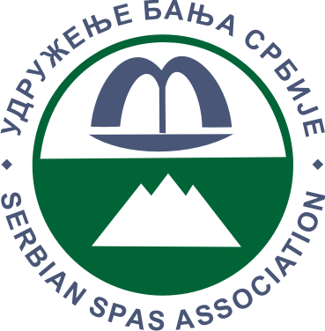
Investing in Thermal Hospitality
A Decade of Regrowth in Serbian Spa Tourism (2014–2023)
Vladan Vešković, secretary general Serbian Spas Association

Slide 2
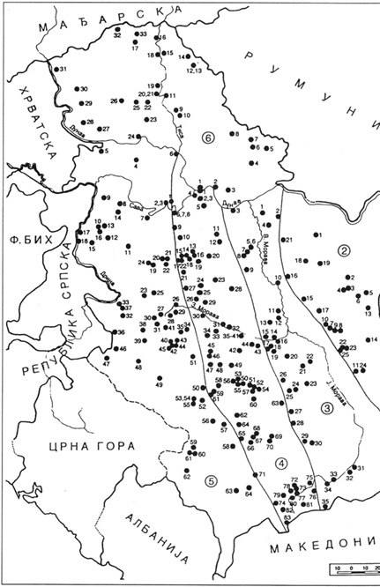
Investment potential in thermal tourism in Serbia
More than 500 springs of thermal and thermo-mineral water but only 30 urbanized spas.
Many opportunities for greenfield investments with the good will of local governments to participate in the realization of new thermal spas
Medical spa tradition longer than two centuries
Professional staff in the field of balneology and catering
Financial and legal support of the state
Better communal and traffic infrastructure
Picture: „Mineral & Thermal water in Serbia, Faculty of Mining and Geology, 2003

Slide 3
Investment potential in thermal tourism in Serbia – more than 500 healing springs
Source: Serbian Spas Association
In the Serbian spas, the most represented are sulphureous waters, alkaline muriatic, alkaline and radioactive

Slide 4
Investment potential in thermal tourism in Serbia - Various medicinal waters
Out of the total number of registered springs in the Serbian spas, the following are the most represented:
Warm water (25°C-30°C) 17%
Hyperthermia (over 42°C) 14%
Homotherms (30°C -35°C), (38°C -42°C) with 13% each

Slide 5
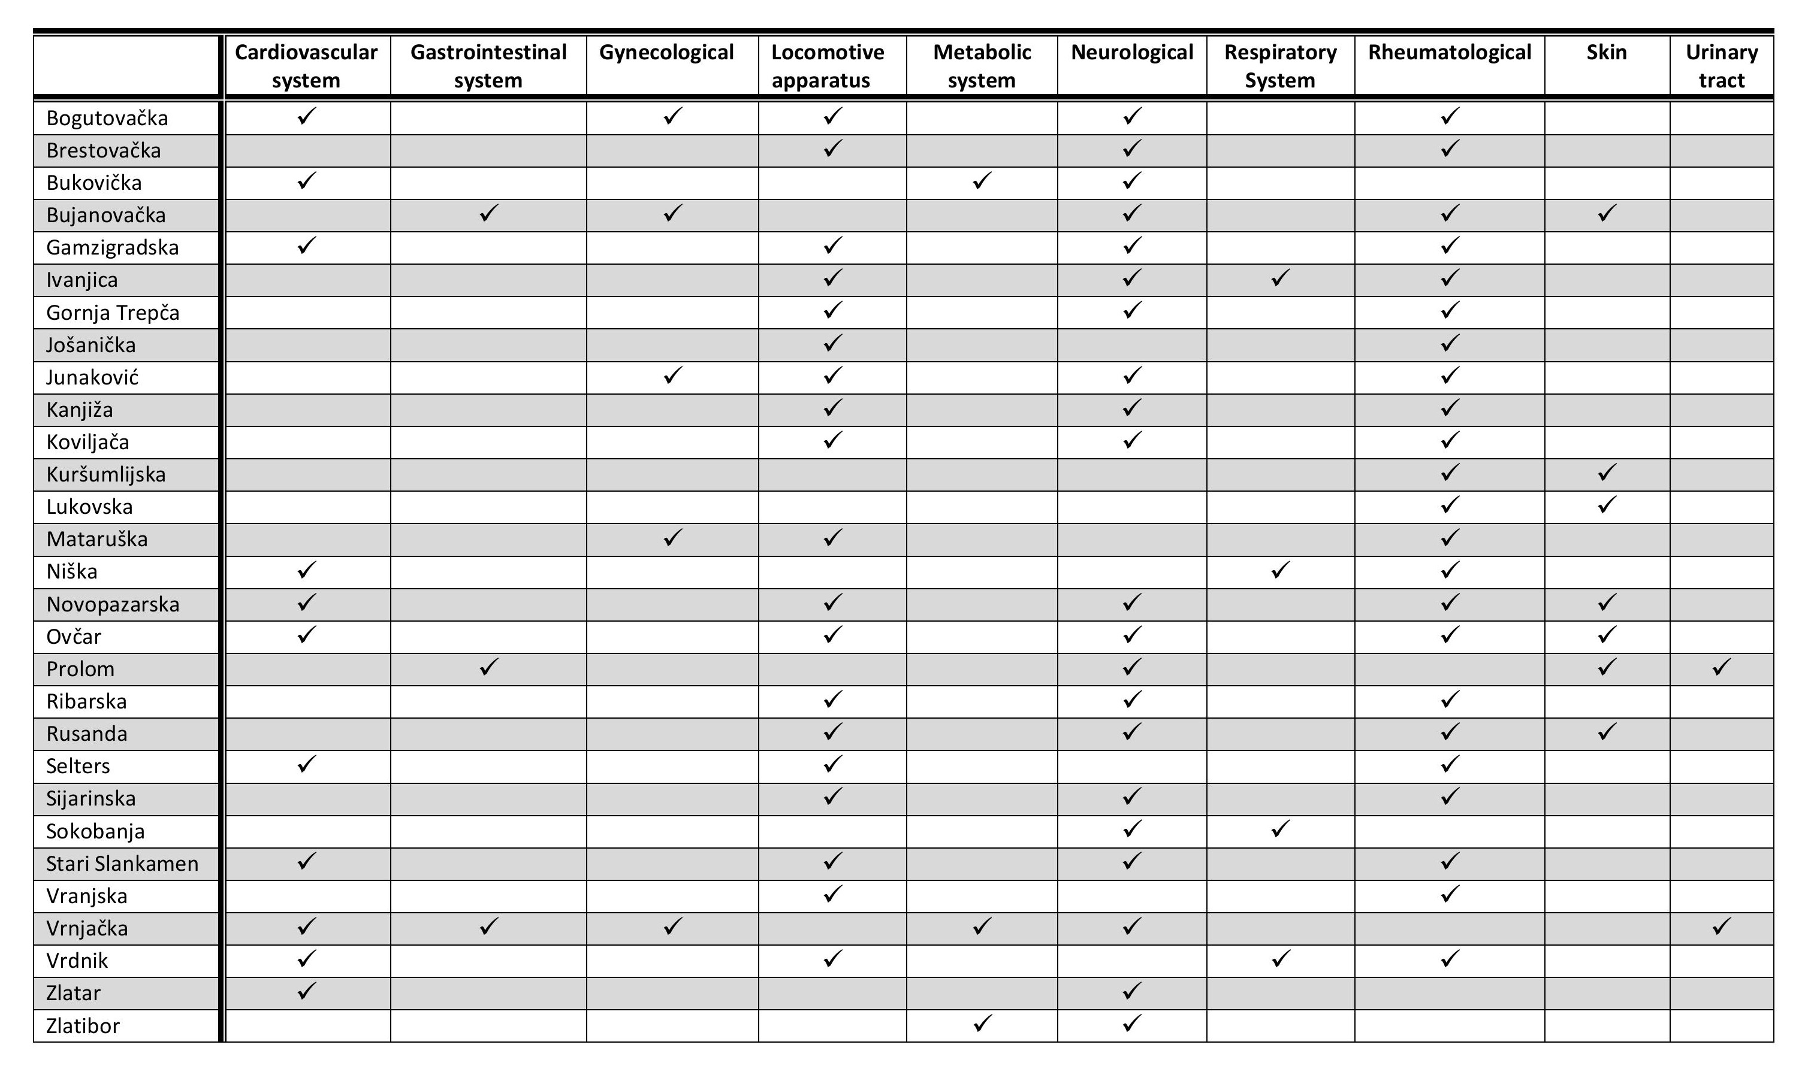
Investment potential in thermal tourism in Serbia - Serbian spas treat most diseases

Slide 6
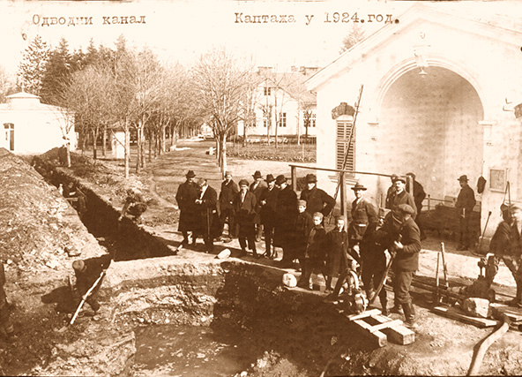
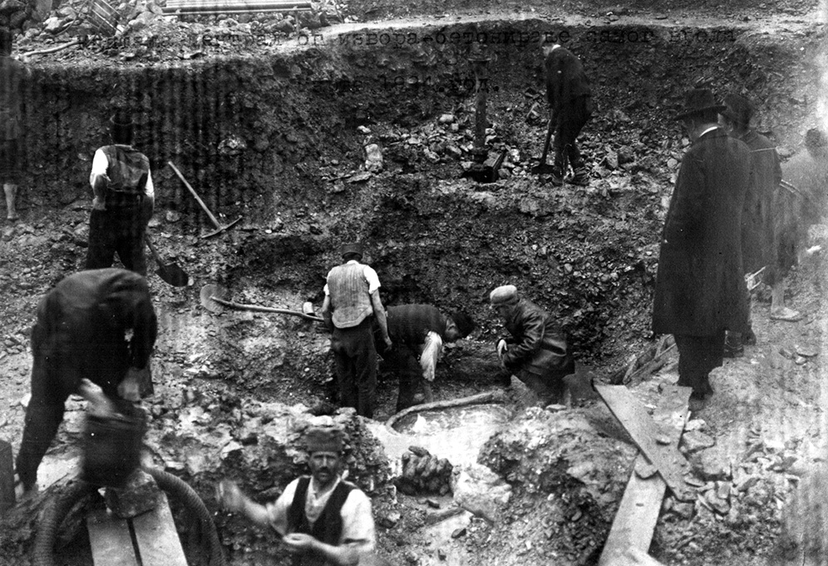
Start of investment in Serbian spas
Since the first written document about the medicinal properties of the Bukovička spa (Aranđelovac) was created in 1811, the era of the creation and development of Serbian spas based on the spas of Western Europe began.
Investment in therapeutic and accommodation facilities began in the 1830s, at the same time as evidence of the medicinal properties of the waters in Serbian spas.

Slide 7
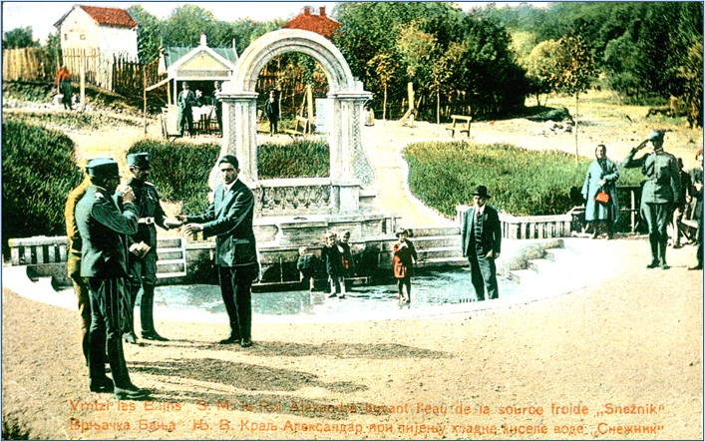
Start of investment in Serbian spas
King Aleksandar Karađorđević, representative of the dynasty that was a major investor in Serbian spas. He used his stay in Vrnjačka banja to recover his body with water from the Snežnik spring.

Slide 8
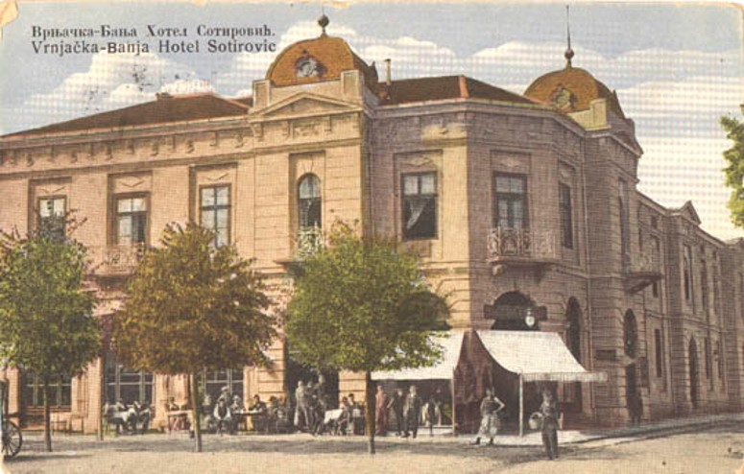
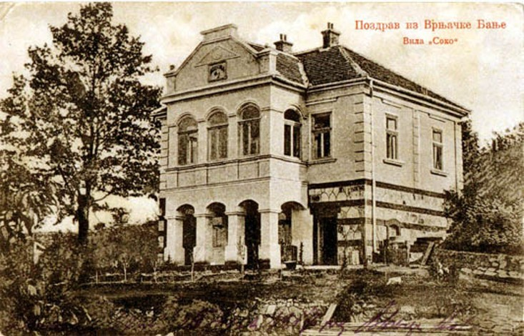
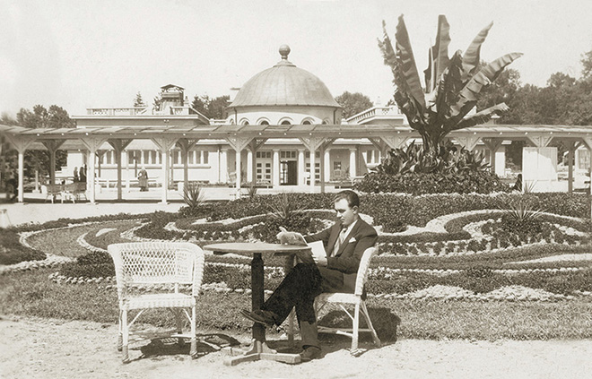
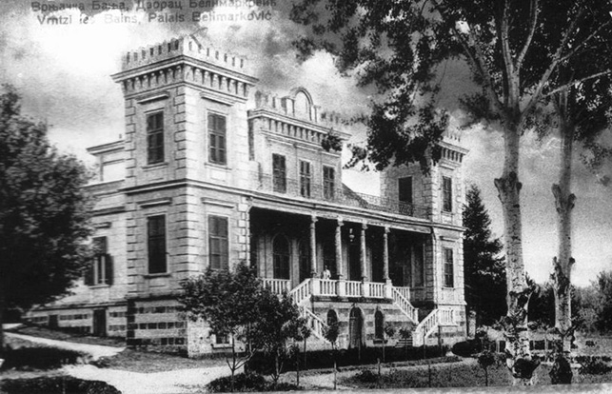
Start of investment in Serbian spas

Slide 9
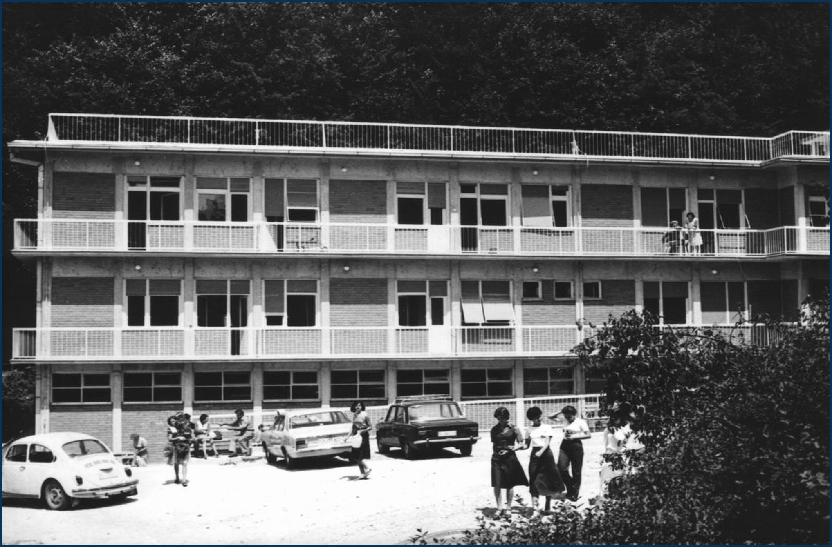
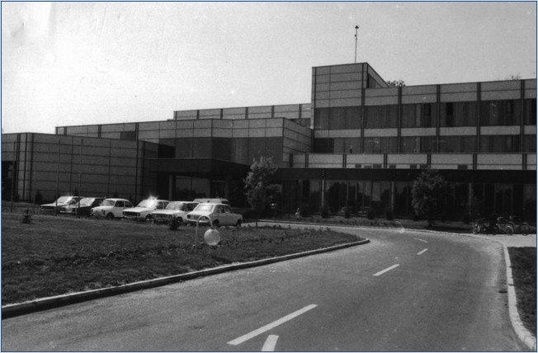
The second phase of investment in Serbian spas
The period after the Second World War brought a different understanding of the role of spas. They were no longer fashionable places to go for health and entertainment but healing places for the masses.
In the 1970s, an enormous investment by the state Pension Fund followed with the construction of 25 completely new and modernly equipped health institutions in Serbian spas.

Slide 10
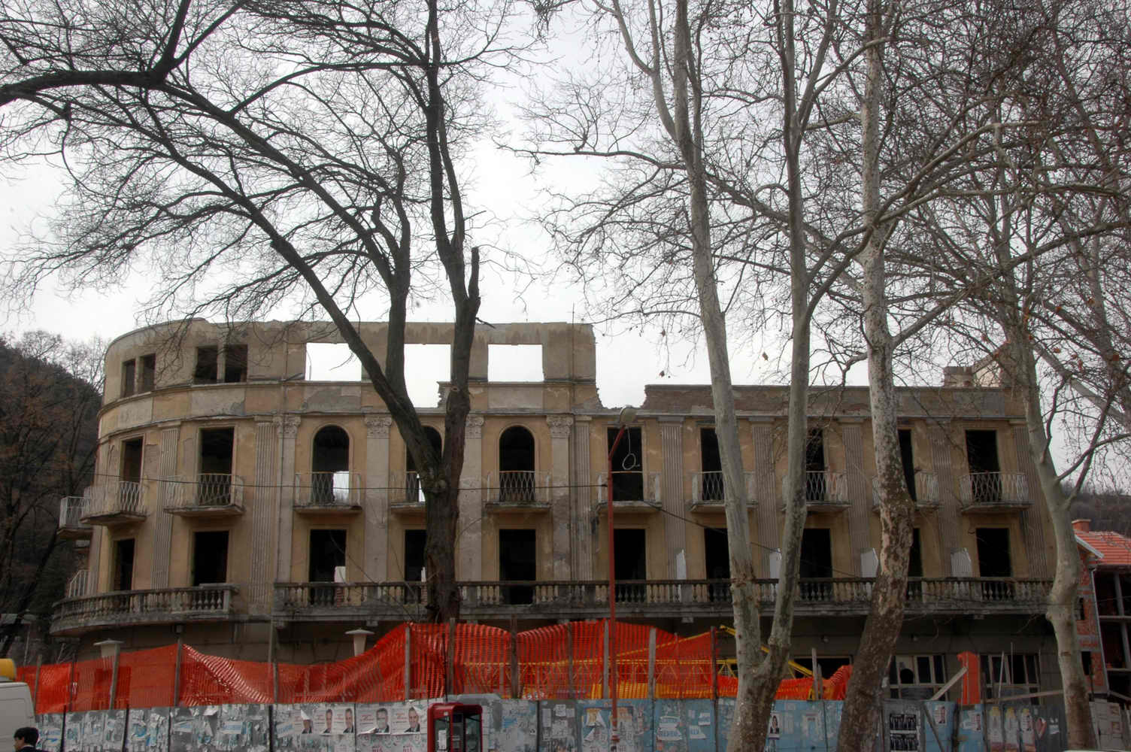
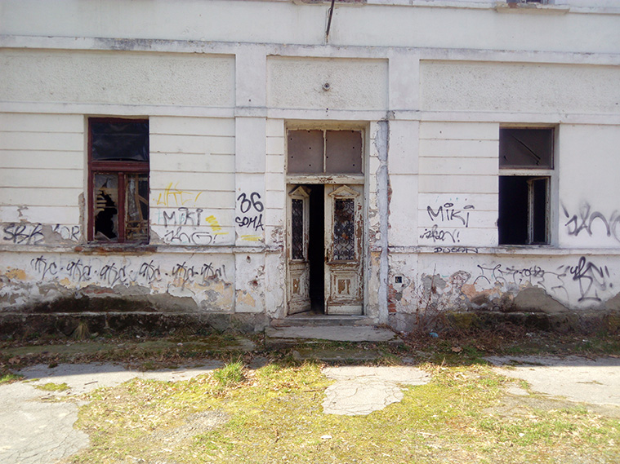
Thermal tourism after the privatization of hotels in Serbian spas (2002 – 2014)
The privatization of accommodation capacities in Serbian spas was carried out without any vision of how the state sees the further development of this segment of Serbian tourism.
That is why Serbian spas lost 17,300 beds (43%) in the period from 2007 to 2015. Most of this number was irretrievably lost, a large part of private accommodation went into the "grey economy", 5,527 beds in state-owned hotels were not in operation.

Slide 11
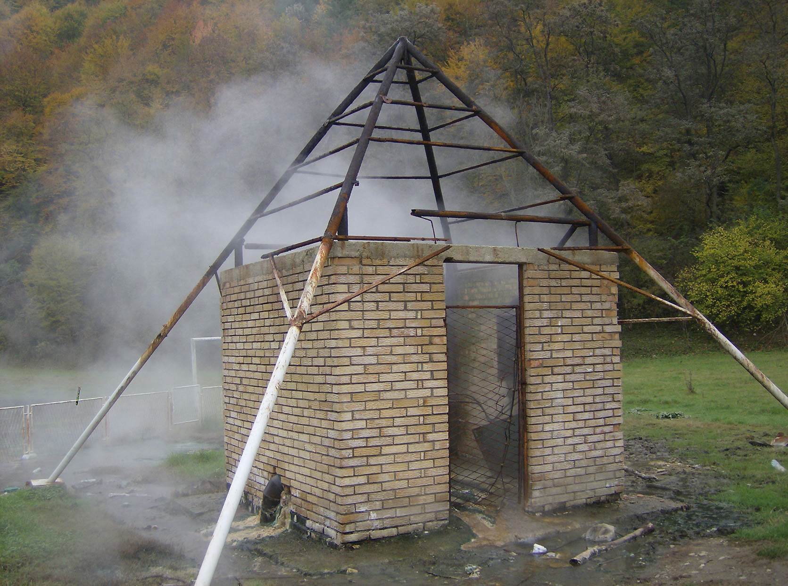
Thermal tourism after the privatization of hotels in Serbian spas (2002 – 2014)
The expected results from creating accommodation facilities in spas are detailed as follows:
• A yearly increase of more than 1,000,000 overnight stays in Serbia, accounting for 14% of the overall traffic recorded in 2015.
• The creation of 2,700 new jobs, mainly in underdeveloped areas. With an average net salary of €300, the Republic of Serbia's budget revenue could see a boost of €1 million from taxes and contributions.
• A rise in tourism income by at least €27.5 million.
• An improvement in local government revenue by €528,000.
• An increase in revenue for the national budget by €3 million from collected VAT.

Slide 12
Investments - the driving force of thermal tourism
It all started in state health facilities in spas
Special hospital for medical rehabilitation MERKUR, Vrnjačka Banja, 2005.
Special hospital for medical rehabilitation, Banja Koviljaca, 2007.

Slide 13
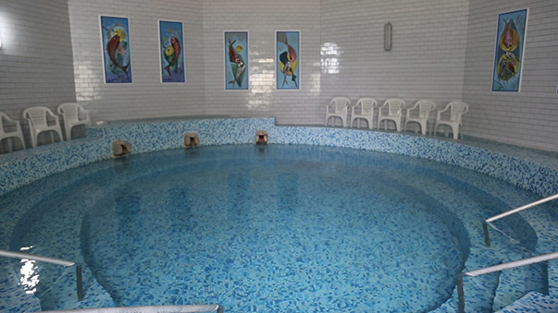
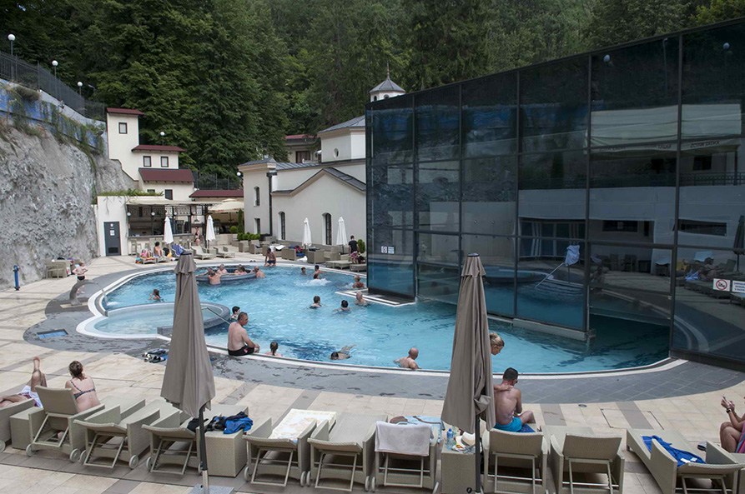
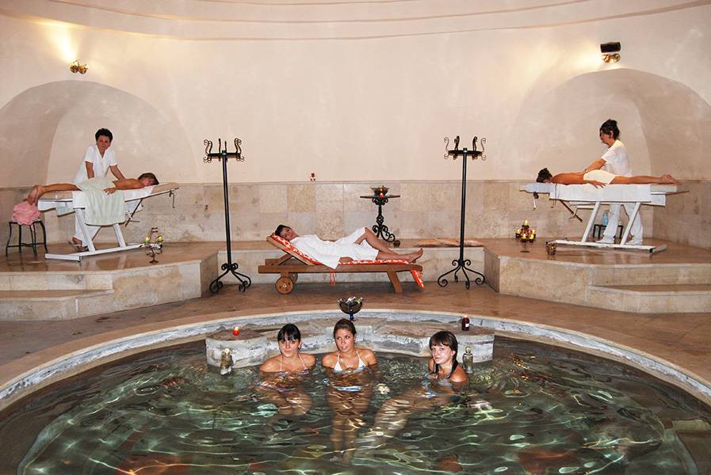
Others followed these two shining examples, so that by 2015 all these institutions in Serbia had some kind of wellness center. Merkur and Koviljača are still at the forefront in developing accompanying content along with medical rehabilitation.
Niska Banja
Ribarska Banja
It can be said that the state-run special rehabilitation hospitals were responsible for the spas remaining on the tourist map of Serbia for almost a decade and a half. This is even more important to mention because as state institutions they had limited (almost no) access to credit lines from commercial banks then and still do now.
Sokobanja

Slide 14
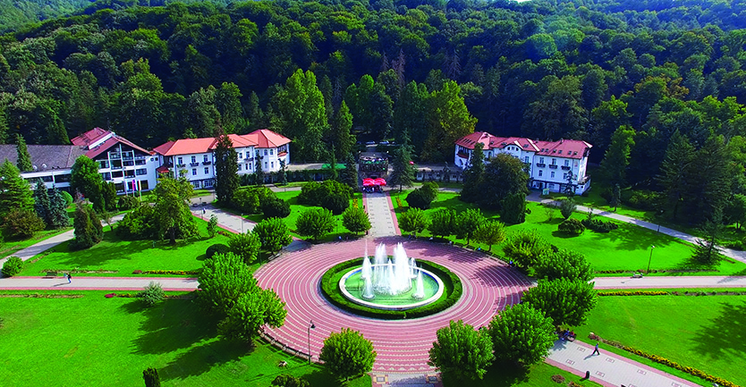
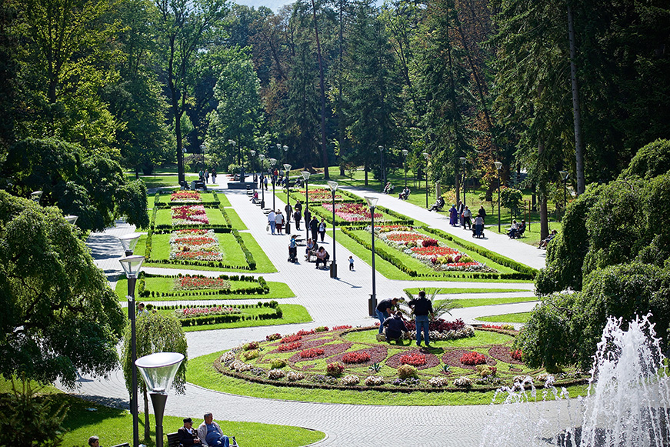
Part of state investments in thermal tourism
In the period from 2015 to 2024, the Ministry of Tourism invested €6.5 million in infrastructure and tourist content in the spas of Serbia.
Banja Koviljaca
We do not have data on the investments of other ministries, but the total investments of the state in the specified period can be estimated at least €10 million.
Vrnjačka Banja

Slide 15
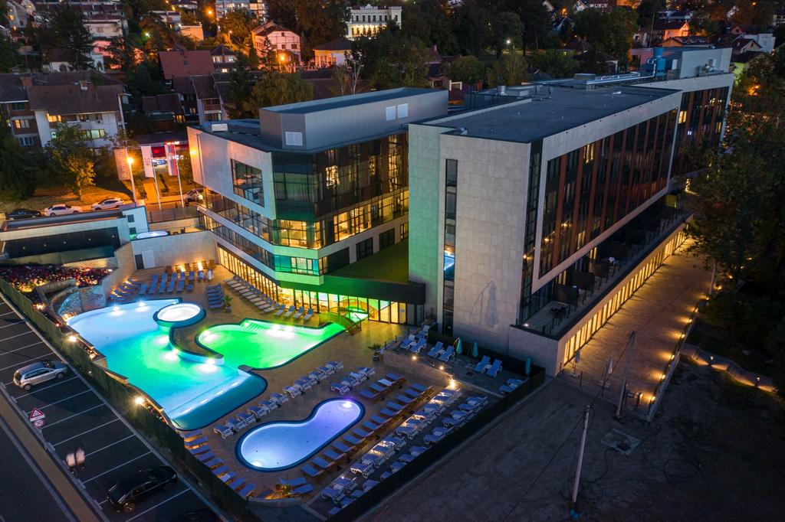
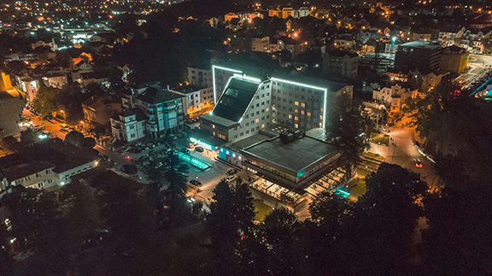
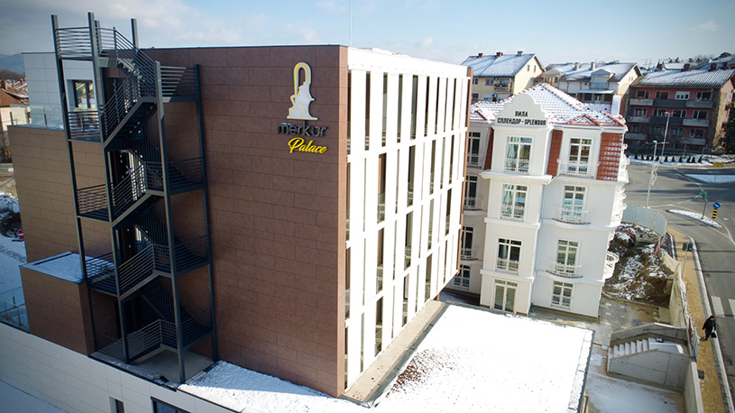
Examples of large investments in thermal tourism
- Vrnjačka Banja -
Hotel TONANTI 4*
Hotel FONTANA 4*
Of great importance for the development of thermal tourism is the decision of the Government of the Republic of Serbia to finance part of the investments in spas and climatic resorts in Serbia from 2019, up to the amount of 2 million euros non-refundable.
Hotel MERKUR PALACE 4*

Slide 16
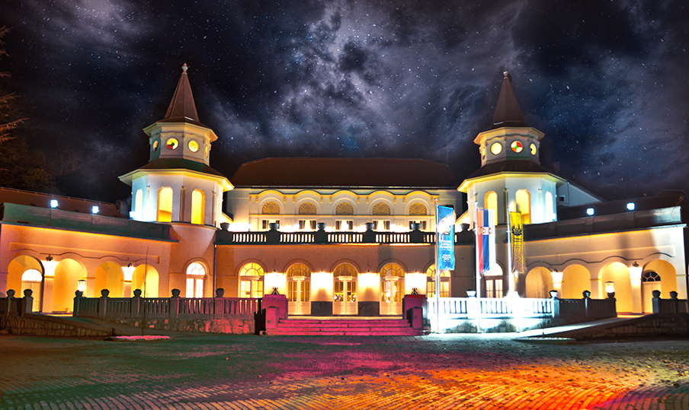
Examples of large investments in thermal tourism
- Banja Koviljača -
Kur salon

Slide 17
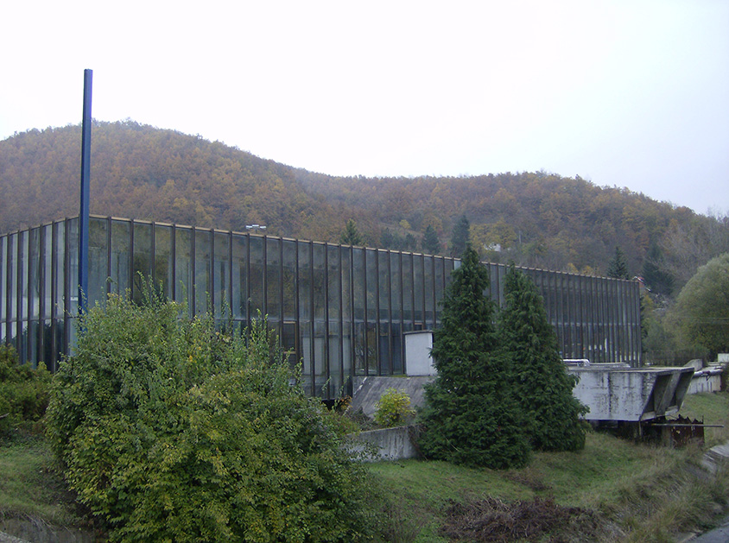
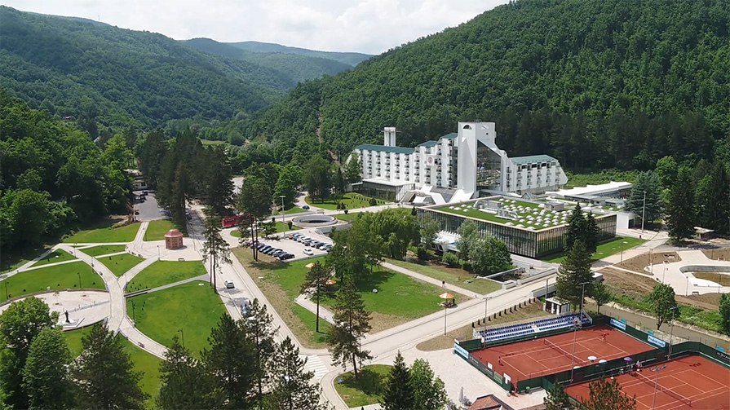
Examples of large investments in thermal tourism
- Kuršumlijska banja -
Before …
… and now

Slide 18
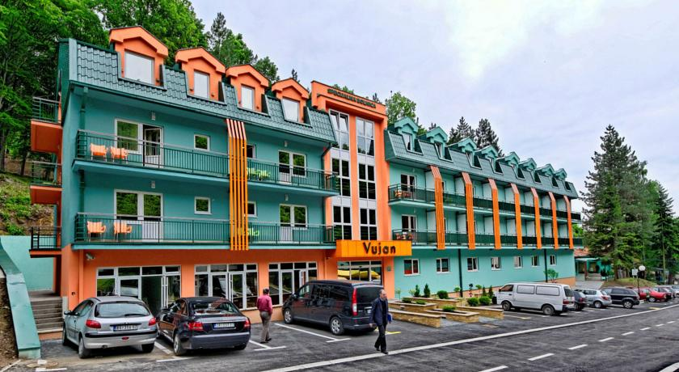
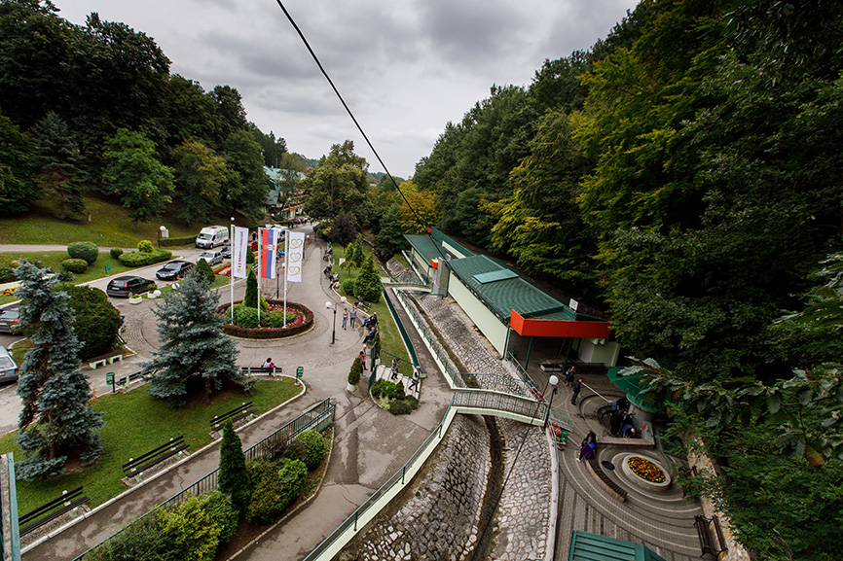
Examples of large investments in thermal tourism
- Gornja Trepča -

Slide 19
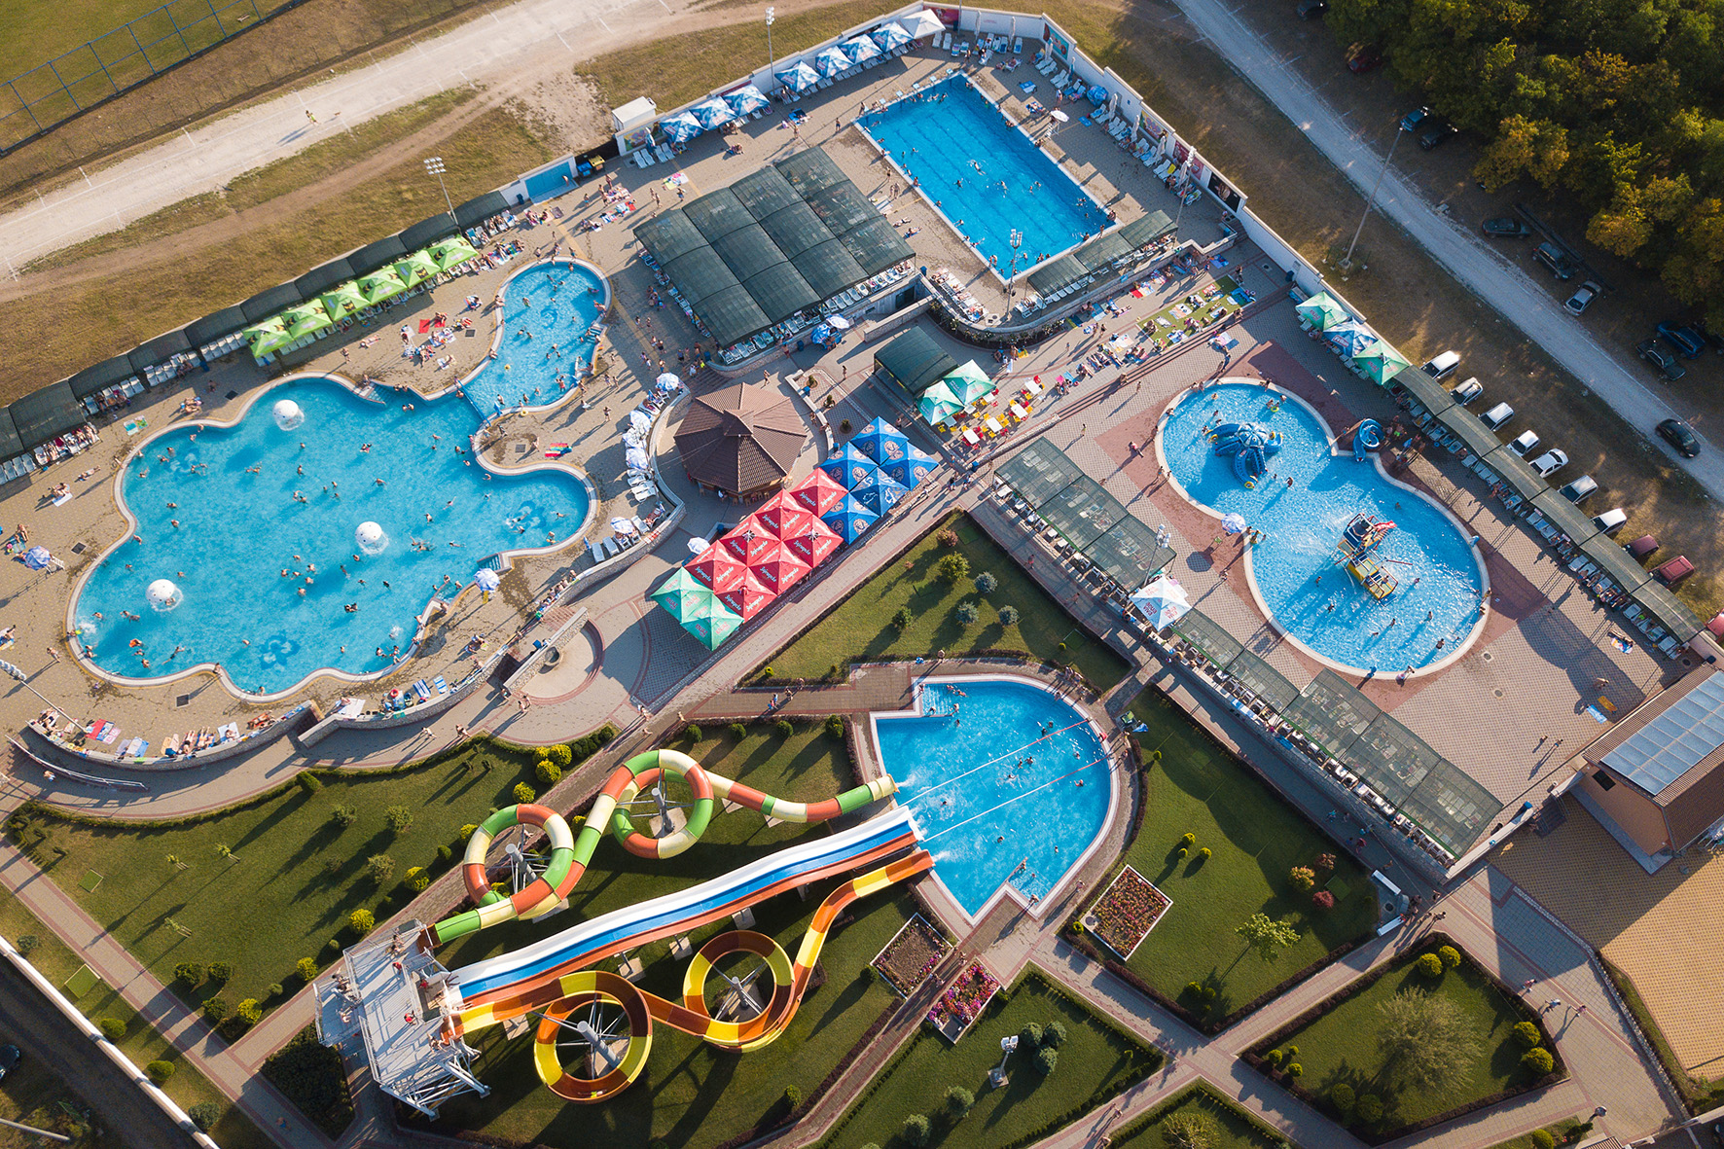
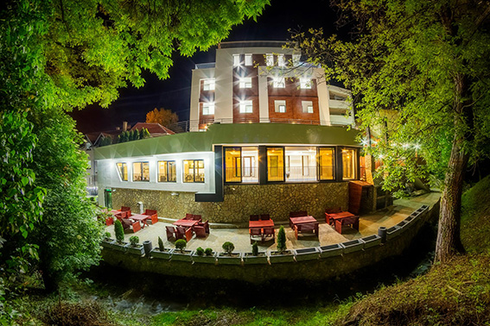
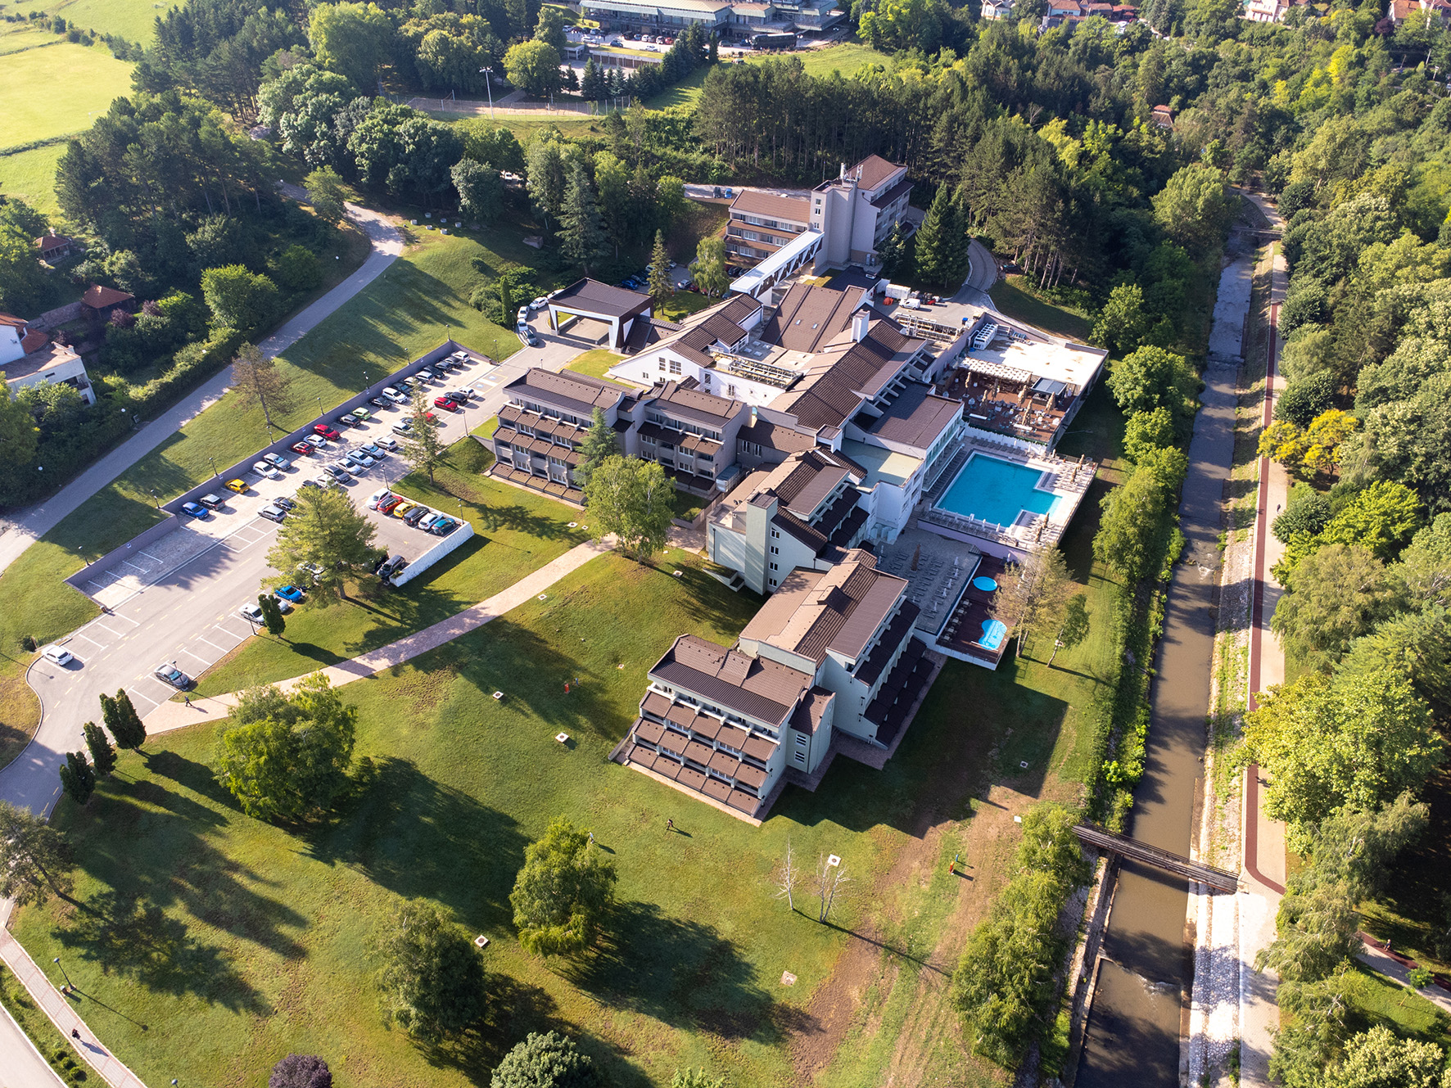
Examples of large investments in thermal tourism
- Sokobanja-
Aqua Park
Nataly Spa
Hotel SUN

Slide 20
Results of investments in thermal tourism
Source: National Institute of Statistics
The direct impact of investments in accommodation capacities and local infrastructure is reflected in a significant increase in the number of overnight stays and a slightly smaller increase in the number of arrivals.
Thermal tourism achieved exceptionally good results during the COVID-19 pandemic in 2020 and 2021.

Slide 21
Results of investments in thermal tourism
Source: National Institute of Statistics
The average length of stay in spas was somewhat reduced due to the change in the age and professional structure of spa guests - younger guests (mostly 35+) with young children and managers, who use their vacation several times during the year, but with shorter stays (Friday/Sunday).
In any case, the average stay in Serbian spas is still longer than 4 days.

Slide 22
Results of investments in thermal tourism
Source: National Institute of Statistics
The positive impact of investments in thermal tourism in Serbia is best seen in the increase in the number of arrivals and overnight stays in the last ten years, when investments were the highest.
The number of arrivals is up by 69.68%, while the number of overnight stays is up by 51.91%, noting that in 2022. the increase in arrivals has almost doubled compared to 2014 (82.21%)!.

Slide 23
I appreciate your attention!
Vladan Veskovic, secretary general
udruzenjebanja@gmail.com

